Slide 1
Unit- 1 Agile Development
KRISHNA BRAHMBHATT
Reference Book:
Software Engineering -A Practitioner’s Approach (Seventh Edition) - Roger S. Pressman.
Chapter 3: Agile Development

Slide 2
✓
Looping
Outline
What is Agility?
Agile Process
Agility Principles
Where agile methodology not work?
Agile Process Models
Extreme Programming (XP)
Scrum
Adaptive Software Development (ASD)
Dynamic Systems Development Method (DSDM)
Feature Driven Development (FDD)
Agile Modelling (AM)

Slide 3
Agility
Agility is ability to move quickly and easily.
It is an ability of quickness, lightness, & ease of movement.
The ability to create and respond to change in order to profit in an unstable global business environment.
The ability to quickly re-prioritize use of resources when requirements, technology, and knowledge shift.
A very fast response to sudden market changes and emerging threats by intensive customer interaction.
Use of evolutionary, incremental, and iterative delivery to converge on an optimal customer solution.
Maximizing BUSINESS VALUE with right sized, just- enough, and just-in-time processes and documentation.

Slide 4


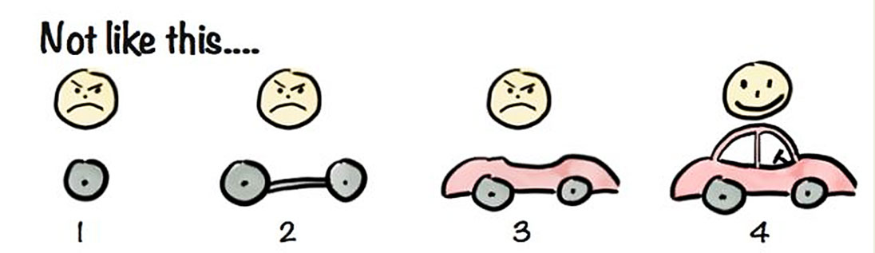

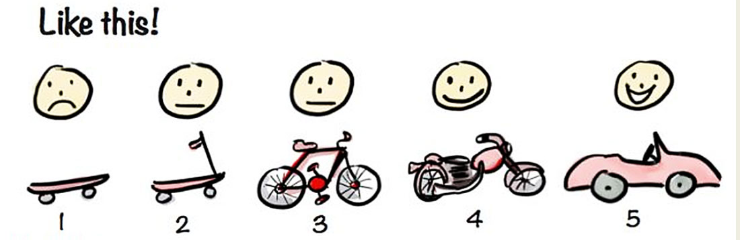

What is Agility? Cont.
Current Functionality
Rapid and Incremental delivery of software
Effective
response
to change
Change Request
Organizing a team
so that it is in control to perform
the work
Effective
communication
among all
stakeholders
Drawing the
customer onto
the team
Eliminate the
“us and them”
attitude
Development
Team
Customer

Slide 5
Agile Process
Agile software process addresses few assumptions
Difficulty in predicting changes of requirements and customer priorities.
For many types of software; design and construction are interleaved (mixed).
Analysis, design, construction and testing are not as predictable as we might like.
An agile process must adapt incrementally.
To accomplish incremental adaptation, an agile team requires customer feedback (so that the appropriate adaptations can be made).

Slide 6
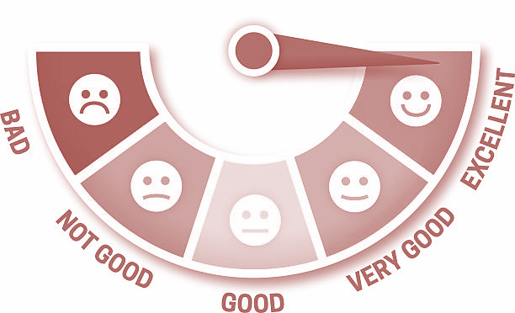


Agility Principles
Highest priority is to satisfy the customer through early & continuous delivery of software
Welcome changing requirements
Deliver working software frequently
Businesspeople and developers must work together
Build projects around motivated individuals
Emphasize face-to-face conversation
Working software is the measure of progress
Continuous attention to technical excellence and good design
Simplicity – the art of maximizing the amount of work done
The best designs emerge from self-organizing teams
The team tunes and adjusts its behaviour to become more effective

Slide 7
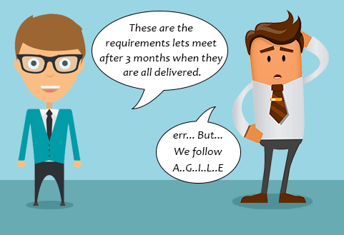
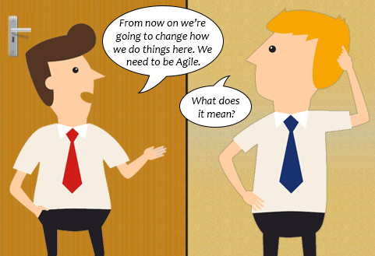

Where agile methodology not work
Project plan & requirements are clear & unlikely to change
Unclear understanding of Agile Approach among Teams
Big Enterprises where team collaboration is tough

Slide 8
Extreme Programming (XP)
The most widely used approach to agile software development
A variant of XP called Industrial XP (IXP) has been proposed to target process for large organizations
It uses object-oriented approach as its preferred development model
XP Values
Communication: To achieve effective communication, it emphasized close & informal (verbal) collaboration between customers and developers
Simplicity: It restricts developers to design for immediate needs not for future needs
Feedback: It is derived from three sources the implemented software, the customer and other software team members, it uses Unit testing as primary testing
Courage: It demands courage (discipline), there is often significant pressure to design for future requirements, XP team must have the discipline (courage) to design for today
Respect: XP team respect among members

Slide 9
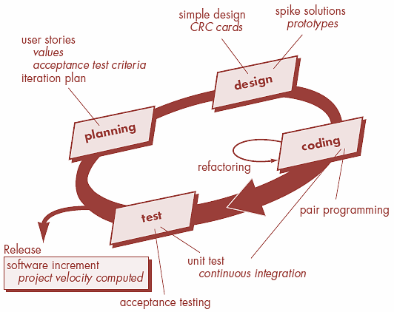
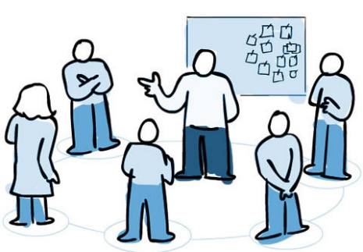
The XP Process
It considers four framework activities
Planning
1. Planning ⬥ 2. Design ⬥ 3. Coding ⬥ 4. Testing
User Stories
Customers assigns value (priority)
Developers assigns cost (number of development weeks)
Project velocity
Computed at the end of first release
Number of stories implemented in first release
Estimates for future release
Guard against over-commitment

Slide 10
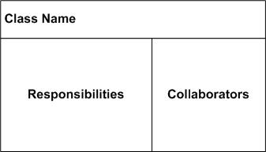


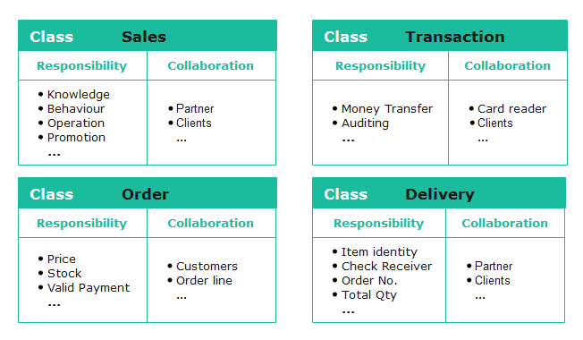
The XP Process cont.
CRC card
Keep-it-Simple (Design of extra functionality is discouraged)
Preparation of CRC card is work project
CRC cards identify and organize object-oriented classes
Spike Solutions (in case of difficult design problem is encountered)
Operational prototype intended to clear confusion
Refactoring
Modify internals of code, No observable change
Design
Develops a series of Unit test for stories included in current release
Complete code perform unit-test to get immediate feedback
XP recommend pair-programming, “Two heads are better than one”
Integrate code with other team members, this “continuous integration” helps to avoid compatibility & interfacing problems, “smoke testing” environment to uncover errors early
Coding
Unit test by developers & fix small problems
Acceptance tests - Specified by customer
This encourages regression testing strategy whenever code is modified
Testing

Slide 11
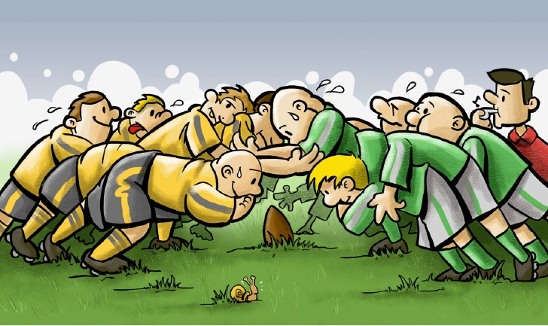



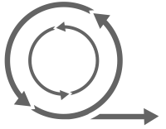
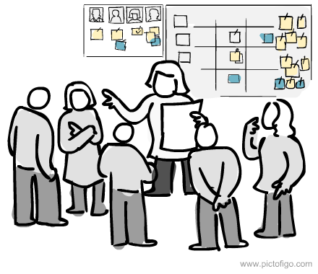
What is Scrum?
Scrum is an agile process model which is used for developing the complex software systems.
It is a lightweight process framework.
Lightweight means the overhead of the process is kept as small as possible in order to maximize the productivity.
Product Backlog
Product Owner
Product
A scrum is a method of restarting play in rugby that involves players packing closely together with their heads down and attempting to gain possession of the ball.
Sprint
Daily Scrum Meeting

Slide 12


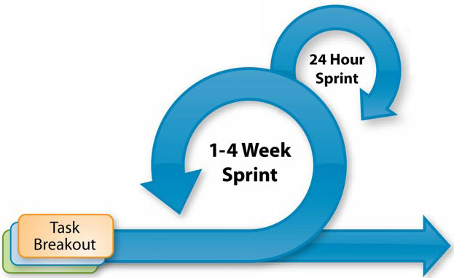





Scrum framework at a glance
Inputs from Customers, Team, Managers
Team Selects starting at top as much as it can commit to deliver by end of sprint
Scrum Master
Daily Scrum Meetings
Sprint Review
Product Owner
Finished Work
Product Backlog
Sprint Planning Meeting
Sprint Backlog
Sprint end date and team deliverable do not change
Sprint Retrospective
Prioritized list of what is required: features, bugs to fix...

Slide 13

Scrum cont.
Backlog
It is a prioritized list of project requirements or features that must be provided to the customer.
The items can be included in the backlog at any time.
The product manager analyses this list and updates the priorities as per the requirements.
Sprint
These are the work units that are needed to achieve the requirements mentioned in the backlogs.
Typically the sprints have fixed duration or time box (of 2 to 4 weeks, 30 days).
Change are not introduced during the sprint.
Thus sprints allow the team members to work in stable and short-term environment

Slide 14
Scrum cont.
Scrum Meetings
There are 15 minutes daily meetings to report the completed activities, obstacles and plan for next activities.
Following are three questions that are mainly discussed during the meetings.
What are the tasks done since last meeting ?
What are the issues that team is facing ?
What are the next activities that are planned?
The scrum master leads the meeting and analyses the response of each team member.
Scrum meeting helps the team to uncover potential problems as early as possible
It leads to “knowledge socialization” & promotes “self-organizing team structure”
Demo
Deliver software increment to customer
Implemented functionalities are demonstrated to the customer

Slide 15
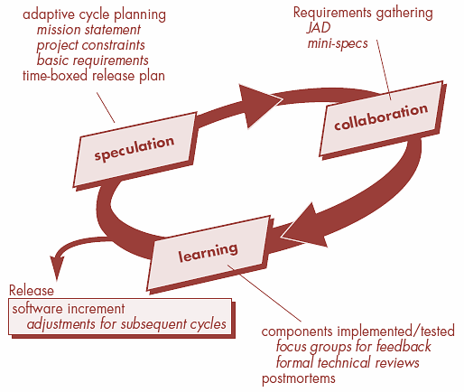
Adaptive Software development (ASD)
This is a technique for building complex software systems using iterative approach.
ASD focus on working in collaboration and team self-organization.
ASD incorporates three phases
Speculation
1. Speculation, 2. Collaboration & 3. Learning
The adaptive cycle planning is conducted.
In this cycle planning mainly three types of information is used
Customer’s mission statement
Project constraints
(Delivery date, budgets etc…)
Basic requirements of the project

Slide 16
Adaptive Software development (ASD) cont.
Collaboration
Learning
In this, collaboration among the members of development team is a key factor.
For successful collaboration and coordination it is necessary to have following qualities in every individual
Emphasize is on learning new skills and techniques.
There are three ways by which the team members learn
Focus groups
The feedback from the end-users is obtained.
Assist each other without resentment (offense)
Formal technical review
This review is conducted for better quality.
Work hard
Posses the required skill set
Postmortems
Team analyses its own performance and makes appropriate improvements.
Communicate problems and help each other
Criticize without any hate

Slide 17
Dynamic Systems Development Methods (DSDM)
Various phases of this life cycle model
Feasibility study: By analysing the business requirements and constraints the viability of the application is determined
Business study: The functional and informational requirements are identified and then the business value of the application is determined
Functional model iteration: The incremental approach is adopted for development
Design and build iteration: If possible design and build activities can be carried out in parallel
Implementation: The software increment is placed in the working environment

Slide 18
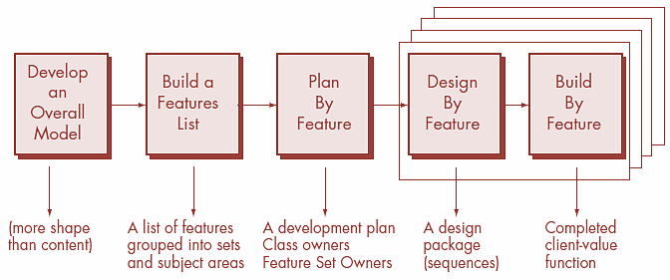
Feature Driven Development (FDD)
It is practical process model for object oriented software engineering
In FDD, the feature means client valued function.

Slide 19
Feature Driven Development (FDD) cont.
1. Develop overall model
Design by feature
The high-level walkthrough of scope and detailed domain walkthrough are conducted to create overall models.
For each feature the sequence diagram is created
Build by feature
2. Build feature list
Finally the class owner develop the actual code for their classes
List of features is created and expressed in the following form
<action> the <result> <by for of to> a(n) <object>
For Ex. “Display product-specifications of the product”
3. Plan by feature
After completing the feature list the development plan is created

Slide 20
Agile Modeling
There are many situations in which software engineers must build large, business critical systems. The scope and complexity of such systems must be modeled so that
(1) All constituencies can better understand what needs to be accomplished.
(2) The problem can be partitioned effectively among the people who must solve it.
(3) Quality can be assessed as the system is being engineered and built.
Various methods have been introduced throughout the years -These methods have merit, but they have proven to be difficult to apply and challenging to sustain (over many projects). Part of the problem is the “weight” of these modeling methods.

Slide 21
Agile Modeling
“Agile Modeling (AM) is a practice-based methodology for effective modeling and documentation of software-based systems. Simply put, Agile Modeling (AM) is a collection of values, principles, and practices for modeling software that can be applied on a software development project in an effective and light-weight manner. Agile models are more effective than traditional models because they are just barely good, they don’t have to be perfect.”
The agile modeling philosophy recognizes that an agile team must have the courage to make decisions that may cause it to reject a design and refactor - We might not have all the answers!

Slide 22
Agile Modeling
Modeling principles that make AM unique are :
Model with a purpose
Know the models and the tools you use to create them
Use multiple models
Adapt locally
Travel light
Content is more important
than representation

